Slide 1
Multiple testing on experimental economics data
Dongyin Hu
Notes:
Hello everyone, I am Dongyin Hu and my project title is An FWER control procedure on experimental economics data. I am from the ECE department and have only a shallow understanding about the economics problem being discussed here. Please correct me if you notice anything that is confusing.

Slide 2



Background
How to raise more money?
Matching grants:
A leadership doner will promise to offer an extra amount to your grant until a predetermined threshold amount is reached.
For example, someone promised a 2:1 matching ratio and the total amount is $25,000. You donate $1, and this person will donate $2.
A rule of thumbs:
The higher the matching ratio is, the more money the fundraiser will receive.
Notes:
In this project, I would like to investigate a problem related with fundraising and charity. An organization may solicite money from subscribers for some reasons, for example, animal protection, improving education in a certain community, or some political events. A key concern for the fundraisers is, how to raise more money? A simple yet difficult question.
In practice, many fundraisers are using a method called matching grants. There is a leadership donor, who promises to offer an extra amount of money to your gift until a predetermined threshold is reached. So for example, when you donate $1, the donor will donate $2, if the matching ratio is 2:1. And the total extra amount is set to a certain limit which can be $25,000 for example. The donor will not add more money if $25,000 has been given out.
There is a rul of thumbs for fundraisers: the higher the matching ratio, the more money will be received. The problem is, is this correct

Slide 3
Exploratory Data Analysis I^{[1]}
amount | freq | HPA | ask1 | ask2 | ask3 | control | treatment | ask | ratio | size | gave | sizeno | years | couple | female | redcty | bluecty | askd1 | askd2 | askd3 | cases | nonlit | ratio2 | ratio3 | size25 | size50 | size100 | MRM2 | dormant | ltmedMRA | red0 | blue0 | close25 | amountchange
0 | 32 | 500 | 750 | 950 | 1125 | 0 | 1 | 1 | 1 | 1 | 0 | 0 | 19 | 0 | 0 | 0 | 1 | 1 | 0 | 0 | 1 | 1 | 0 | 0 | 1 | 0 | 0 | 19 | 1 | 0 | 1 | 0 | 0 | -150
40 | 41 | 100 | 125 | 160 | 190 | 0 | 1 | 1 | 2 | 3 | 1 | 0 | 19 | 1 | 0 | 1 | 0 | 1 | 0 | 0 | 2 | 6 | 1 | 0 | 0 | 0 | 1 | 7 | 0 | 0 | 1 | 0 | 0 | -20
Treatment is three-fold:
the price ratio of the match: 1:1, 2:1, or 3:1
the maximum size of the matching gift across all donations:
$25,000, $50,000, $100,000, and unstated.
the example donation amount suggested to the donor:
equal, 1.25 times, or 1.5 times the highest previous contribution
Subgroups are divided on:
State and county (2004 election)
Marital status, gender, legal status
Outcome:
The response rate
dollars given not including the matching amount
dollars given including the matching amount,
the change in the amount given (not including the matching amount)
[1] Karlan, Dean, and John A. List. "Does price matter in charitable giving? Evidence from a large-scale natural field experiment." American Economic Review 97.5 (2007): 1774-1793.
Notes:
So, in a 2007 work, several researchers conducted an experiement to see the effect of matching grants. They sent out letters to solicite contributions from previous donors. In addition to the matching ratios we discussed before, more factors are considered as well: the maximum amout of of the matching gift and the suggested donation amount are changed for different donors. For the matching ratios, they tested 3 ratios. For the maximum amount, they set 4 values, and for the suggested smount, 3 levels are set as well. This results a total of 36 treaments, which is color coded in blue as shown in the sample data.
Also, since the reason for raising money is political, the researchers also divided the donors into 4 subgroups, which are red/blue state and red/blue counties. This is color coded in yellow. Note some other onformation is collected as well, such as marital status, gender or legal status.
Finally, there are four outcomes of interest - the reponse rate, defined as the number of donation received over the total number of letters sent out, dollars given without the matching amount, dollars given with the matching amount, and the changed inthe amount given.

Slide 4
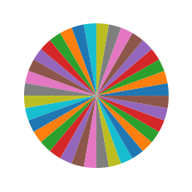
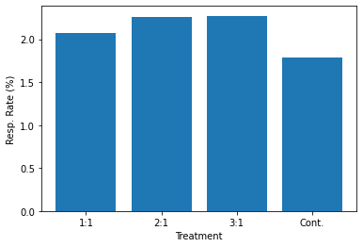
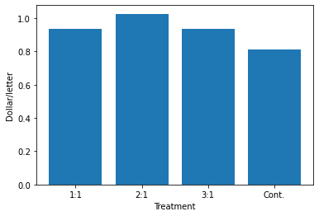
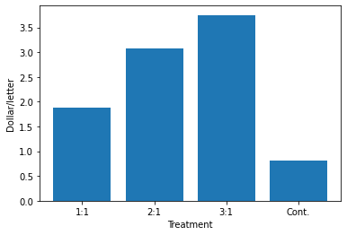
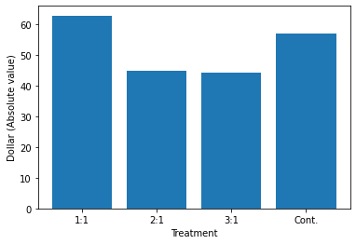
Exploratory Data Analysis II
36 treatments in total
Basic statistics:
Sample size 50,083 with 1/3 (16,687) assigned to control group.
11,133/11,134/11,129 for different ratios.
Response rate amount w/o matching / letter amount with matching / letter amount change
(Standard deviations are too large, omitted)
Notes:
Now let's look at some statistics about the results. A total number of 50k subjects are asked, and 1/3 of them are assigned to the control group. The 36 treatments are assigned with equal possibility to all in the treatment groups.
And for the outcomes we concern, they are shown in the 4 bar charts w.r.t. the matching ratios, From the left to the right are reponse rates, amount w/o matching per letter, amount with matching per letter, and amount change. And the x-axis is a 1:1 ratio, 2:2 ratio, 3:1 ratio and the control group. We can see that the reponse rate of the three treatment groups seems to be higher, and the amount w/o matching per letter is higher as well. Note this amount is normalized by the size of each group. And for the amount with matching, of course that is higher than the control group. For the amount change, not a clear trend is observed.

Slide 5
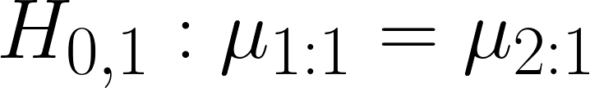
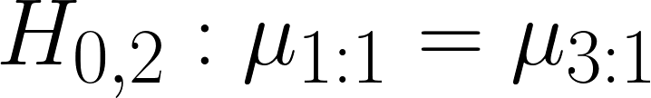
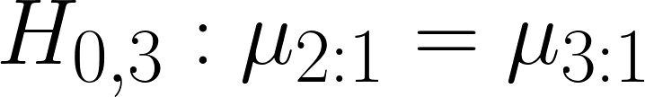
Initial Analysis
Q. Does the matching ratio influences the four outcomes (for example, amount w/o matching)?
Let’s do some simple testing. Wald testing of 2 means and permutation testing with T = |Mean1 - Mean2|.
 | Wald, p = Pr(|w| > |wn|) | Permutation, p = sum(I(Ti > Tn)) / B
 | 0.05507*^{[2]} | 0.02996**
 | 0.47538 | 0.76099
 | 0.99239 | 0.50389
 | 0.45227 | 0.22675
I want to exam more!
Multiple treatments (36), multiple subgroups(4 and more), multiple outcomes (4) -> multiple testing -> FWER control^{[2]}.
[1] List, J. A., Shaikh, A. M., & Xu, Y. (2019). Multiple hypothesis testing in experimental economics. Experimental Economics, 22(4), 773-793.
[2] Note: * and ** indicates that the corresponding p-values less than 10% and 5%, respectively.
Notes:
Now let us do some simple testing to see whether the rule of thumbs works. We ask, does the match ratio influences the amount w/o matching per letter?
A Wald test is conducted for 4 null hypotheses. First is the control group agiant all treatment groups. The remaining tests are 3 possible combiantions of different matching ratios. From these results it seems that a weak evidence against the null hypothesis H_0, and no evidence against the rest hypotheses. A quick interpretation is, using matching ratio is somehow helpful but the a higher ratio does not help fundraisers to attract more donations.
But what if I want to test more? We have so many treatments, subgroups and outcomes. The problem then becomes a multi-testing problem. I will follow a work published in 2019 to control the FWER as we testing more hypothesis. The procedure they proposed offers asymptotic control of the familywise error rate.

Slide 6
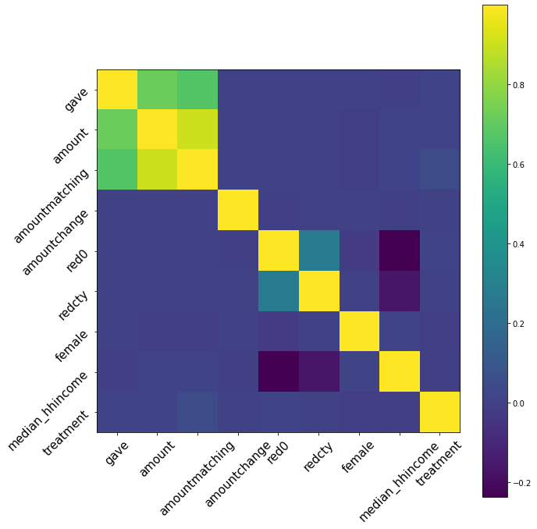
Suggestions
Covariance analysis for subgroups
Mention which testings are following the work and which are proposing
Demographic information

